Slide 1
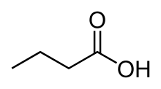
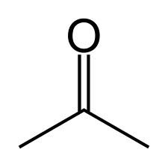
DKA
Diabetic Ketoacidosis
HHS
Hyperosmolar hyperglycemic State
Hyperosmolar: High solute (salts) due to loss of water.
Hyperglycemic: high glucose due to gluconeogenesis
DM (usually type-2) patient has little insulin.
Body tries to increase glucose production
Body produces counterregulatory hormones
A type of metabolic acidosis caused by lack of insulin in patients with DM.
DM (usually type 1) patient does not have enough insulin.
Body tries to find other forms of fuel
Lipolysis
cortisol
glucagon
Free Fatty Acids
catecholamines
growth hormone
hyperglycemia
Ketone bodies
Osmotic diuresis
Acetone
Dehydration
Acetoacetate
β-hydroxybutyrate
Hyperosmolarity: dehydration = less water in body = more solute (salt) in body = high concentration of solute = hyperosmolarity
Ketoacidosis
Notes:
Nonketotic coma is usually precipitated by an infection,[2] myocardial infarction, stroke or another acute illness. A relative insulin deficiency leads to a serum glucose that is usually higher than 33 mmol/l (600 mg/dl), and a resulting serum osmolarity that is greater than 350 mOsm. This leads to polyuria (excessive urination, an osmotic diuresis), which, in turn, leads to volume depletion and hemoconcentration that causes a further increase in blood glucose level. Ketosis is absent because the presence of some insulin inhibits lipolysis.

Slide 2
 | DKA Diabetic ketoacidosis | HHS (Hyperosmolar Hyperglycemia State)
Onset | Within 24 hr | Several days
pH Normal: 7.4 | Acidic H ions move inside cells: K ions move outside cells (hyperkalemia) | ----
HCO3 22-28 | Low < 15 | Normal > 15
Anion Gap | > 10 | normal
Ketones | Positive | small
Glucose | > 250 mg/dL | > 600 mg/dL
Osmolality | Normal | > 320

Slide 3
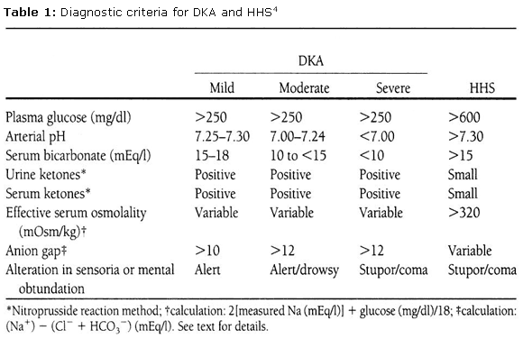

Slide 4
Equations to know:
Anion Gap (AG) = Na – Cl – HCO3
normal: 6-16
anion gap (AG) represents the concentration of all the unmeasured anions in the plasma. If patient is going through metabolic acidosis, H reacts with HCO3- to produce CO2. CO2 is breathed out. Overall effect is decrease in HCO3 which means AG increases.
Plasma Osmolality = 2Na + (glucose/18) + (BUN/2.8)
Normal: 280 – 295 mOsm/kg water
Hyperosmolality causes coma b/c water in brain is moved into plasma
Corrected Na =
Na +
1.6(glucose-100)
100
add 1.6 mEq sodium for each 100 mg plasma glucose >100mg/dl
Normal blood glucose = 100 mg/dl (that’s why its glucose-100)
Notes:
The acid anions (eg lactate, acetoacetate, sulphate) produced during a metabolic acidosis are not measured as part of the usual laboratory biochemical profile. The H⁺ produced reacts with bicarbonate anions (buffering) and the CO₂ produced is excreted via the lungs (respiratory compensation). The net effect is a decrease in the concentration of measured anions (ie HCO₃) and an increase in the concentration of unmeasured anions (the acid anions) so the anion gap increases.
ecause we know that plasma is electro-neutral we can conclude that the anion gap calculation represents the concentration of unmeasured anions.

Slide 5
Treatment of both
DKA & HHS
Monitor:
Chem 7
Osmolality
Ketones
ABG
CBC
Hydration
Insulin
Potassium
Goal: Hydration, decrease osmolality, improved VS (BP, HR, RR)
Monitor:
VS q1h
Chem 7 q1hr

Slide 6
Hydration
Normal Na: 135-145 mEq/L
Step 1:
0.9% Normal Saline IV 1L/hr
Step 2: within 1hr
Calculate Corrected Na:
Na = Na + 1.6(glu-100)/100
Normal Na: 135-145
Re-evaluate
Every hour
Step 4:
If Na > 135 then
Use ½ NS 5mg/kg/h
Step 4:
If Na < 135 then
Continue NS 5mg/kg/h
Step 5:
DKA: if BG < 250 mg/dl then add 5% dextrose (including NS)
HHS: if BG < 300 mg/dl then add 5% dextrose (including NS)
Notes:
Step 4: it’s 4-14 ml/kg/h (I used 5 ml/kg/h so its easy to remember)

Slide 7
Treatment of both
DKA & HHS
Monitor:
Chem 7
Osmolality
Ketones
ABG
CBC
Hydration
Insulin
Potassium
Goal: decrease BG by 50 – 70 mg/dl/hr, stop ketosis
Monitor:
BG q1h
ABG q4-6h
K q1h

Slide 8
Insulin
Step 1:
Insulin Bolus:
0.1 Units/kg
If K < 3.5
Then d/c insulin
Step 2:
Insulin Infusion:
100 Units Regular insulin in 100 ml NS
0.1 Units/kg/1hr
Check in 1 hour
If K < 3.5
Then d/c insulin
Step 3:
If BG Δ < 50 mg/dl/1h
Then double IV insulin: 0.2 U/kg
Check in 1 hour
Step 3:
If Δ BG: 50 – 70
Keep insulin
Step 3:
If Δ BG > 70 mg/dl/1h
Then ½ IV insulin: 0.05 U/kg/h
Step 4:
If BG reaches 300 mg/dl
Then ½ IV insulin: 0.05 U/kg/h
Notes:
Infusion: 5-10 units/hr is normal = 5-10 ml/hr

Slide 9
Treatment of both
DKA & HHS
Monitor:
Chem 7
Osmolality
Ketones
ABG
CBC
Hydration
Insulin
Potassium

Slide 10
Potassium
Normal: 3.5 – 5 mEq/L
Scale: 3.3 – 5.3
Goal: establish adequate renal function
If K < 3.3
Then d/c insulin
Add 40 mEq Potassium/L
If K: 3.3 - 5.3
Then add 20 mEq Potassium/L
If K > 5.3
Then monitor q2h
Since patient is given insulin, insulin causes K channels to close, keeping K inside cells = hypokalemia (low K in blood). If patient is given insulin, they also must be given K.
If K is low: d/c insulin and give K
If K is normal: give K (to prevent hypokalemia)
If K is high: good (monitor)
Notes:
Normal K value: 3.5 – 5 mEq/L
Volume of blood: 4.7L
If K is within range: add 20 mEq/1L K
IV + volume of blood = 1 + 4.7 = 5.7 L
Amount of K: 20 mEq
Concentration: 20 mEq/5.7 = 3.5 mEq/L K (which is at the bottom of normal range)
If K is too low: add 40 mEq K
IV + Volume of blood = 0 + 4.7 = 5.7
Amount of K: 40 mEq
Concentration: 40 mEq/5.7 = 7 mEq/L K

